Slide 1
Smart Waste Classification System
Subject: Capstone Project 2
Team Members:
Paras Godhani
Priya Patel
Sukhjit Kaur
Rutvi Patel
Emmanuel Araoyinbo
ORGANIC
PLASTIC
PAPER

Slide 2


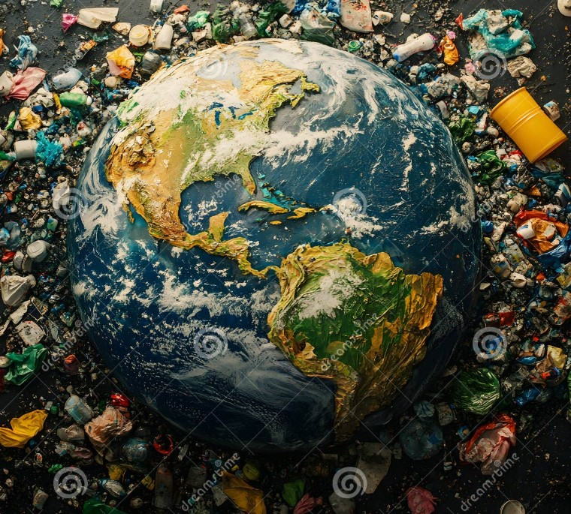

Introduction & Problem Statement
• Waste management is a growing global issue with increasing volumes annually.
• Inefficient segregation results in poor recycling and environmental degradation.
• This project aims to automate waste classification using AI techniques to improve efficiency and sustainability.

Slide 3
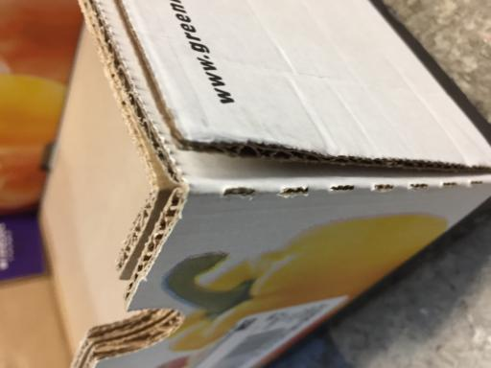
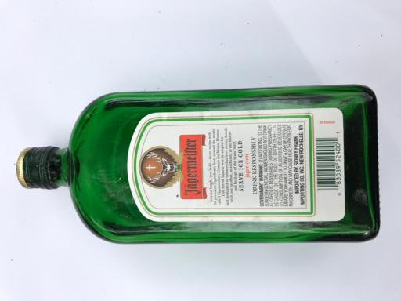

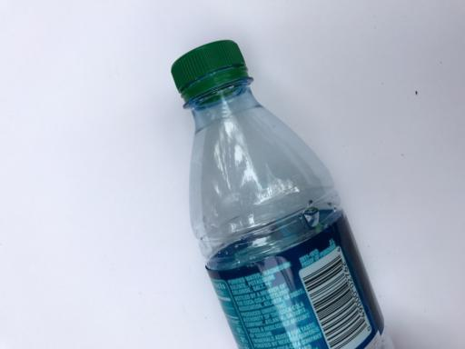
Dataset Information
TrashNet Enhanced:
A waste classification dataset optimized from Hugging Face technologies.
We have selected a dataset that contains total 2527 images of different categories of waste (e.g., plastic, paper, glass) which has total six different categories.
Cardboard
Glass
Paper
Plastic

Slide 4
Methodology
Process Flow:
Data Collection: Sourced from the TrashNet dataset with labeled waste images.
Preprocessing & Augmentation: Images were resized, normalized, and augmented (rotation, flip, zoom) to balance classes and improve generalization.
Model Design: A Convolutional Neural Network (CNN) was developed to automatically extract spatial features from waste images.
Transfer Learning: Implemented transfer learning using pretrained models VGG16, ResNet50, Mobile Net, and InceptionV3 to enhance image classification performance with limited data.
Evaluation: Performance was measured using accuracy, precision, recall, confusion matrix and F1 score, supported by visual analysis of results.

Slide 5
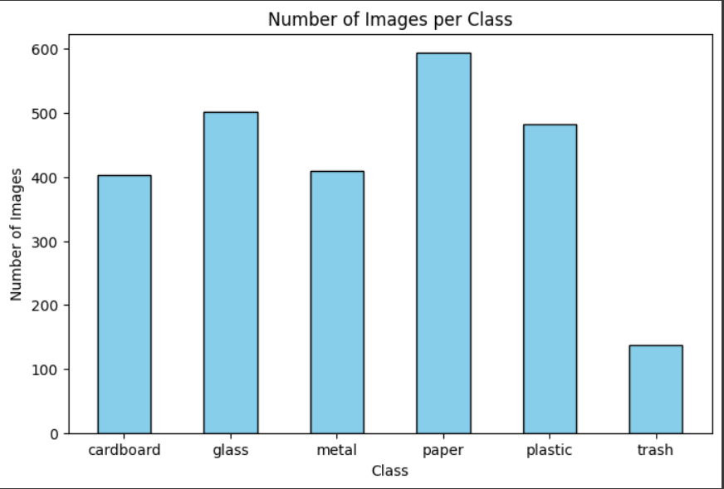
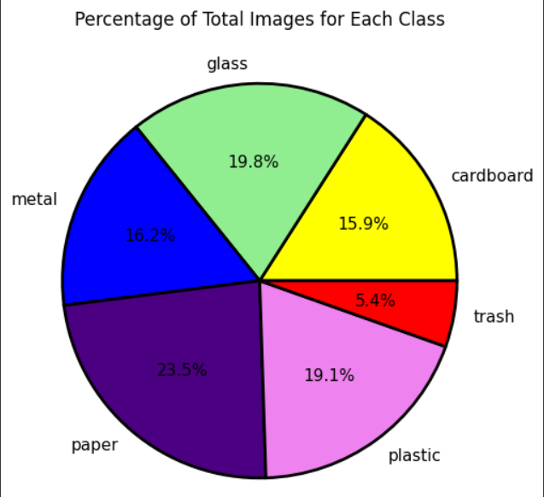
Data Analysis
Bar Chart: Displays the absolute count of images in each waste category, helping to identify class imbalances.
Pie Chart: Illustrates the percentage distribution of images per class, providing a visual summary of dataset composition.

Slide 6
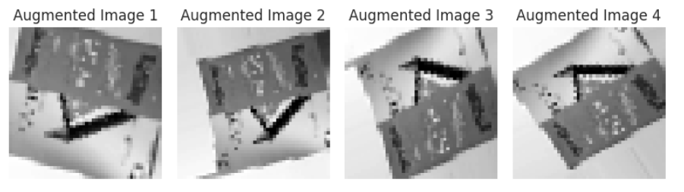

Data Preprocessing
Data Labeling: Each image needs to be labeled correctly according to the waste category it represents.
Data Augmentation: Data augmentation techniques like flipping, rotation, zooming, and cropping can artificially expand your dataset.
Original Image

Slide 7
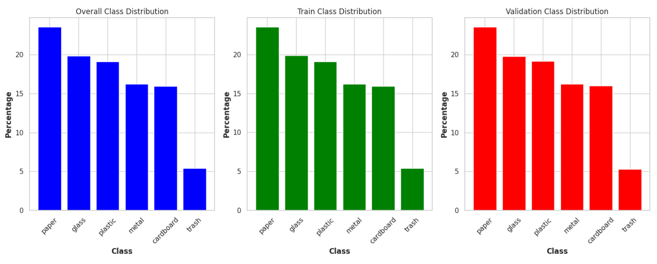
Data Preprocessing
Resizing and Scaling: Images should be resized to a fixed size to ensure uniformity when feeding them into the CNN model.
Class Distribution :A bar chart showing how the dataset is split into training and validation sets for each class.
Proper distribution ensures the model does not memorize data but actually understands patterns.

Slide 8
Model Design
Paper
Input layer
Convolution layer
Convolution layer
Convolution layer
Convolution layer
Flatten
Plastic
384
384
3
64
64
256
(x3)
128
128
512
(x4)
256
256
1024
(x6)
512
512
2048
(x3)
2048
Input
Image
Metal
Cardboard
Glass
Trash

Slide 9
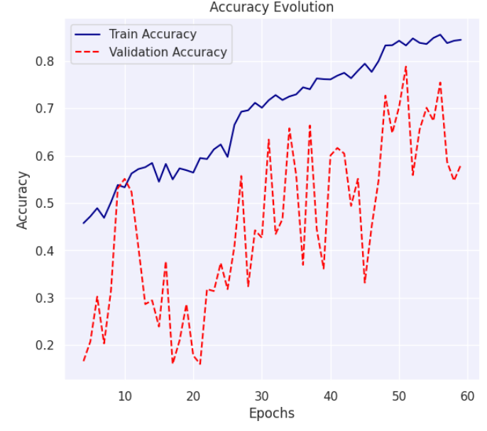
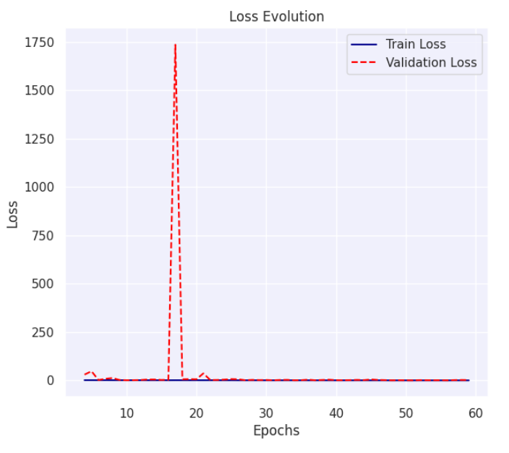
Loss and Accuracy Evaluation
A line chart showing how the model's accuracy improves, and loss decreases over training and validation epochs.
Explanation:
Accuracy shows how well the model correctly classifies waste. A higher accuracy over time indicates improvement. In our case it reaches up to 72% .
Loss represents the model’s mistakes. A decreasing loss means the model is learning.

Slide 10
Transfer Learning Techniques
Transfer learning is a machine learning technique where a model developed for one task is reused as the starting point for a model on a second, related task.
It is especially popular in deep learning where large models trained on massive datasets (like vgg ,resnet, ImageNet) can be fine-tuned for more specific, smaller tasks.
VGG16 : VGG16 achieved an accuracy of 80%, providing a strong baseline for our image classification task.
RESNET50 : ResNet50 outperformed all other models with an impressive accuracy of 93%, making it the most effective architecture for our dataset
Mobile Net : Mobile Net delivered a solid performance with 85% accuracy, balancing efficiency and accuracy well
Inception V3 :InceptionV3 reached an accuracy of 87%, showcasing its strength in handling complex image features.

Slide 11
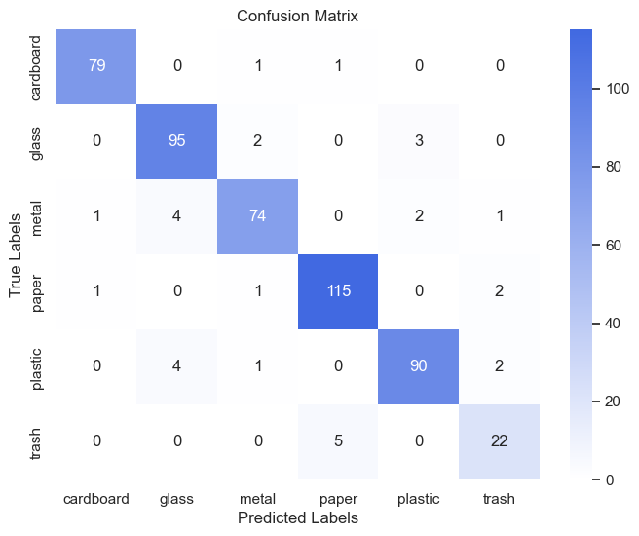
Confusion Matrix For Best Model
A confusion matrix showing where the model makes mistakes.
Explanation:
This chart compares predictions vs. actual categories to see which waste types are misclassified.
Darker boxes show more accurate predictions (e.g., 95 correct classification for glass)
Errors indicate misclassification (e.g., some trash classified for paper.)
Helps in fine- tuning the model for better accuracy.

Slide 12
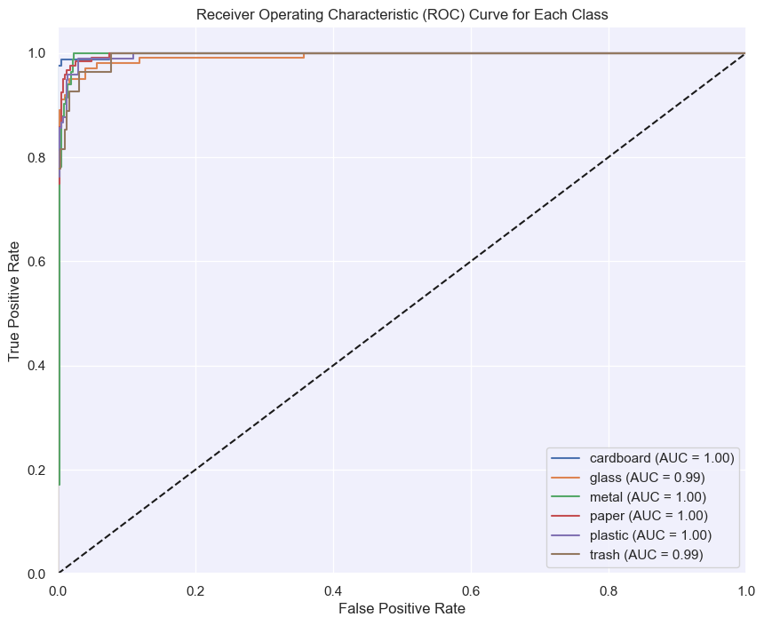
ROC-AUC curve for resnet50
The ROC curve shows excellent classification performance across all waste categories using ResNet-50.
The AUC values are extremely high, with cardboard, metal, paper, and plastic achieving a perfect 1.00, and glass and trash scoring 0.99.
This indicates the model is highly effective at distinguishing between the different classes with minimal false positives.
Such strong AUC metrics highlight ResNet-50's robustness and reliability for multi-class waste classification tasks.

Slide 13
Challenges and Limitations
Class Imbalance:
Some waste categories have fewer images, leading to biased models.
Solution: Use oversampling, class weights, or data augmentation.
Misclassification of Similar Materials:
Materials like plastic and paper are visually similar, causing misclassifications.
Solution: Combine image analysis with sensor data or fine-tune the model.
Computational Costs:
Training deep learning models requires high-end hardware, leading to expensive resources.
Solution: Use cloud services or optimize models with techniques like pruning and transfer learning.
Hardware Limitations:
Limited GPU access, session timeouts, memory constraints, temporary storage loss, performance variability.
Solution: Use Google Colab for better GPU access and periodically save work to Google Drive.

Slide 14
Next Steps
Expanded Dataset:
Collect more real-world waste images to improve model accuracy and generalization.
Website Interface:
Develop a website that allows users to scan and classify waste, providing smart waste management solutions while offering suggestions on how to repurpose or dispose of waste effectively.
OpenCV Integration: We integrated OpenCV for real-time image processing, enhancing object detection and classification efficiency directly from live camera input.
Transfer Learning:
Various pretrained models will be evaluated to optimize performance and achieve high accuracy across different datasets.

Slide 15
Conclusion
Our Smart Waste Classification model achieved 93% accuracy on a well-curated dataset with the use of transfer learning techniques.
Leveraged advanced data preprocessing and transfer learning techniques to boost performance.
Demonstrated high effectiveness in accurately identifying and categorizing waste types.
The model serves as a valuable tool for automated waste management, contributing to smarter and more sustainable solutions.

Slide 16
References
Hugging Face. (n.d.). Hugging Face Dataset Library. Retrieved February 7, 2025, from https://huggingface.co/datasets?search=trashne
Environmental Protection Agency. (n.d.). Waste management and recycling resources. Retrieved February 7, 2025, from https://www.epa.gov/recycle
Waste Connections of Canada. (n.d.). Disposal/recycle guide. Retrieved February 7, 2025, from https://www.wasteconnectionscanada.com/disposalrecycle-guide/
Smith, J., & Doe, A. (2022). Advances in convolutional neural networks for waste classification. Journal of Environmental Informatics. Retrieved February 7, 2025, from https://www.researchgate.net/publication/383000159_Environment_friendly_Plastic_Garbage_Classification_Using_Convolution_Neural_Network

Slide 17

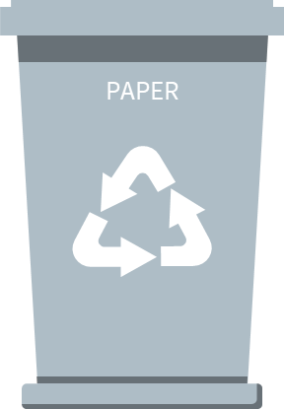
Thanks!
Do you have any questions?
ORGANIC

